Slide 1
Service Oriented Architecture
BHAVANA
DAY 45
05/06/2024

Slide 2
High Level SOA Reference Architecture
These slides outline the document provide by IBM to CMU to guide CMU’s development of a Student Service Suite (S³) SOA.
Work on this documented was completed in March of 2008.
In this course, we will use this document as a case study in SOA design.
See Blackboard’s Course Documents section.

Slide 3
1. The Introduction(1)
Introduction
The organization is described.
The IT vision is outlined.
The IT vision includes a discussion of:
Interoperability,
Composition,
Geographic distribution and
Reuse of legacy code.

Slide 4
1. The Introduction(2)
Forces that drive the need for agility:
Pressures on the industry as a
whole.
Pressures associated with main
stakeholders.
Pressures from the
environment (legal, economic, social,
and technological).
Agile organizations adapt and survive.

Slide 5
1. The Introduction(3)
This is a high level roadmap and maturity model for a staged transition to SOA adoption.
Intended Readers include:
Executives
IT Architects
Developers

Slide 6
1. The Introduction(4)
Scope of Document
A methodology is described to generate a list of services and iteratively move from business requirements to service identification.

Slide 7
1. The Introduction(5)
Usage of Document
Governance body IT Team Business Team
or Center of Excellence
If SOA opportunity {
Understand vision, value proposition
and approach
Specific architectural
decisions
Design Application
architecture
}
else
adopt traditional approach

Slide 8
2. Current IT Environment(1)
Student Information System developed in 1989/1990
Provides functionality to perform key student activities such as admissions, enrollments, registration, financial aid and so on.
The SIS is the primary application that is within the scope of the S³ effort.

Slide 9
2. Current IT Environment(2)
Current SIS
JSP/Java
HTML/CGI
Scripts
O
T
H
E
R
S
Y
S
T
E
M
S
CGI(Faucet
BSD Shell
Commands)
JDBC
Ingres forms
C
Procedures
Batch
scripts
SCP
SFTP
SIS Database (Ingres)

Slide 10
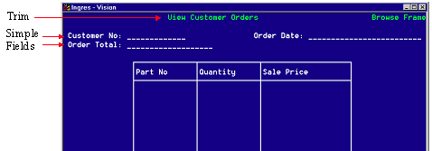
Ingres Forms

Slide 11
2. Current IT Environment(3)
Primary application environment for SIS is Ingres
hosted on HP 4400 running HP/UX Version 11
Business logic encapsulated in C procedures
Over 400 Ingress forms screens providing various
functionality
End users use SSH to access the system
Close to 200 batch processes constitute core of the
processing related to information extraction, information
updates as well as reporting
Batch program scheduling is performed by Xi-batch scheduler
Batch programs are written in the C programming language
… The report contains more detail but this gives us a flavor.

Slide 12
Enterprise Integration Patterns
Review the four integration styles:
File Transfer
Shared Database
Remote Procedure Call
Messaging

Slide 13
2. Current IT Environment(4)
SIS System Interfaces
Oracle
Financials
Folderwave
Blackboard
SIS
Mellon Bank
Library
Housing
IRS
Parking
More than 20 other systems
are shown in the actual document.

Slide 14
2. Current IT Environment(5)
SIS 2.0 is on hold.
The proposed SIS 2.0 Architecture
Server side presentation
layer
EIS Database
Client side
Presentation
layer
Business
services
layer
Data services
layer
(View)
(Controller)
Database
HTML DOCS
JSP
Servlet
EJB
Dataservices
class
Multi-tier architecture
Promoting separation of concerns
Better security
Better scalability
Work already completed is expected
to compliment the SOA approach
Technical specifications:
JBoss App server
JBoss Web server
Oracle 10g DBMS
Web ISO (a layer over
Kerberos)

Slide 15
2. Current I.T. Environment (6)
Challenges:
- No reference architecture implies
* Different stakeholders take
different approaches.
* Unmanageable, isolated,
difficult-to-secure mix of
systems and technologies

Slide 16
2. Current I.T. Environment (7)
Challenges:
- The point-to-point external
integrations imply
* increases in complexity
* unreliability
* difficult to audit
* lacking in agility

Slide 17
2. Current I.T. Environment (8)
Challenges:
-Tight coupling within and
between SIS systems
-Technology focused rather than
business focused
-Heterogeneity may become
unmanageable
-Inconsistent version control
-Mostly unstructured (flat file) data
exchange

Slide 18
2. Current I.T. Environment (9)
Challenges
-Current governance structure
cannot adequately address issues
related to shared data and
services
-Lack of adequate system
monitoring
-Many external systems are accessed
and utilized w/o standard interfaces,
policies, or SLA’s.

Slide 19
3. SOA Reference Architecture Requirements
Underlying principles:
Agility (design for change)
Use of standards (promotes loose coupling, prevents lock-in)
Separation of concerns (separation of business logic from integration promotes maintainability)
Reuse (leverage existing enterprise assets)

Slide 20
3. SOA Reference Architecture Specific Requirements
Integration and messaging patterns (ESB usage)
Availability (failover, redundancy) of reference architecture components
Security
Auditing and monitoring
Open source tools must be considered
Use of BPEL must be addressed
International campuses
Interfaces with other education institutions and federal agencies
Connectivity, scalability, availability with other campuses must be considered

Slide 21
4. The Architecture(1)
Vision for the new architecture:
Agile, reusable, use of web protocols, ease of discovery
Rigid, hard-wired approach replaced with “plug-and-play”, “choreographed” approach.
Diverse operating systems, data base management systems, applications and frameworks exist at CMU.
Standardized interfaces make services platform-,location-, and device-independent.
Complexity of integration addressed with widely available web protocols.

Slide 22
4. The Architecture(2)
Instituting an Architectural Discipline
Focus on near and long term horizon
Clearly defined long-term business direction
Identify near-term business initiatives
Create “rolling waves” of near-term business initiatives

Slide 23
4. The Architecture(3)
SOA Value Proposition
Flexible, agile to change, composite applications (e.g. track a student from high school to job application and beyond)
Increase quality and scalability (e.g. facilitate transfer of credit to and from other institutions)
Make knowledge maintainable (e.g. provide ability to make decisions about whether a new program is viable)
Make key data accessible and usable everywhere (e.g. make student records available to advisors, instructors, external entities, and federal agencies)
Reduce risk and exposure (e.g. provide efficient audit and logging mechanisms)

Slide 24
4. The Architecture(4)
Current and future I.T. Landscape
Not state-of-the-art but quite stable
Meets the needs of the university quite well
Fairly maintainable in its current form
Is not optimally positioned to address the ever-changing needs of higher education
An evolutionary (not revolutionary) approach is needed
The university has committed itself to SOA

Slide 25
4. The Architecture(5)
From | To
Function oriented | Process oriented
Build to last | Build to change
Prolonged development cycles | Incrementally built and deployed
Application silos | Orchestrated solutions
Tightly coupled | Loosely coupled
Structuring applications using components or objects | Structure applications using services
Known implementation | Implementation abstraction
SOA - an evolution in objectives

Slide 26
4. The Architecture(6)
SOA - multiple viewpoints

Slide 27
4. The Architecture(7)
SOA - three key roles: consumer, provider, registry

Slide 28
4. The Architecture(8)
Building an SOA - a Closer look at services
Services in a Service-Oriented Architecture are always:
Stateless
SOA services neither remember the last thing they
were asked to do, nor care what the next is. Services
are not dependent on the context or state of other services
– only on their functionality.
Discoverable
A service must be “discoverable” by potential consumers of
the service – if a service is not known to exist, it is unlikely
ever to be used. Services are “published” or “exposed” by
service providers in the SOA service directory, from which
they are discovered and invoked by service consumers.

Slide 29
4. The Architecture(9)
Building an SOA - a Closer look at services
Self-describing
The SOA service interface describes, exposes, and provides
an “entry point” to the service. The interface contains all
the information a service consumer needs to discover and
connect to the service, without ever requiring the consumer
to understand (or even see) the technical implementation details.
Composable
SOA services are, by nature, composite. They can be composed
from other services – and, in turn, can be combined with other
services to compose new business solutions. Composition is
typically achieved through choreography, using tools that
implement standards such as BPEL4WS (Business Process
Execution Language for Web Services).

Slide 30
4. The Architecture(10)
Building an SOA - a Closer look at services
Single-instance
Only one implementation of a given service should exist
in an SOA.
Loosely coupled
Loose coupling allows the concerns of application features
to be separated into independent pieces. This “separation
of concern” provides a mechanism for one service to call
another without being tightly bound to it.

Slide 31
4. The Architecture(11)
Building an SOA - a Closer look at services
Governed by policy
Services are built by contract. Relationships between
services (and between services and service domains)
are governed by policies and service-level agreements
(SLAs), promoting process consistency and reducing
complexity.
Independent of location, language, and protocol
Services are designed to be location-transparent and
protocol/platform-independent (generally speaking,
to be accessible to any authorized user, on any platform,
from any location).

Slide 32
4. The Architecture(12)
Building an SOA - a Closer look at services
In addition, services in a service-oriented
architecture are typically:
As Coarse-grained as possible
Services are typically coarse-grained business functions.
Granularity is a statement of functional richness for a service –
the more coarse-grained a service is, the richer the function
offered by the service. Coarse-grained services reduce
complexity for system developers by limiting the steps
necessary to fulfill a given business function, and they
reduce strain on system resources by limiting the “chattiness”
of the electronic conversation.

Slide 33
4. The Architecture(13)
Building an SOA - a Closer look at services
Potentially Asynchronous
Asynchronous communication is not required of an SOA service,
but it increases system scalability through asynchronous behavior
and queuing techniques. Unpredictable network latency and
high communications costs can slow response times in an SOA
environment, due to the distributed nature of services –
asynchronous behavior and queuing allow a service to issue
a service request and then continue processing until a response
is returned by the service provider.

Slide 34
4. The Architecture(14)
Architectural Principles
Technology should help business in time to market
Technology should be an enabler of business not an end in itself
Flexibility
Loose coupling and separation of concerns
Reuse existing components and services
Maximize language and platform neutrality
Use proven technologies
Standards based
Design for interoperability
Business aligned services not web services for their own sake
Security
Auditability and logging

Slide 35
4. The Architecture(15)
Architectural Principles
Ease of use
Buy what you can build what you must
Reliability
Simple trumps complex

Slide 36
Next Time
Enterprise view
IT Systems View
Middleware view
Solution stack view

Slide 37
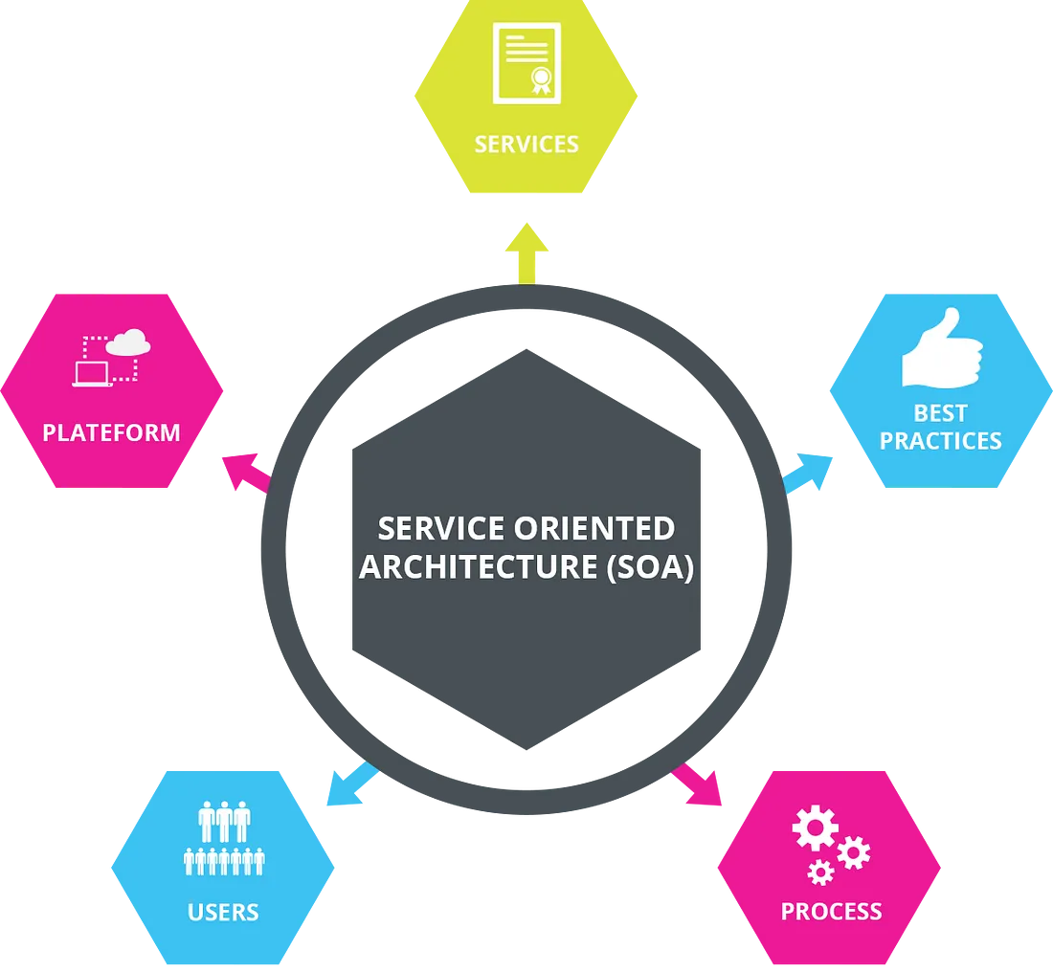
6/5/24, 3:39 PM
What Is Service-Oriented Architecture? | by Software Development Community | Medium
What Is Service-Oriented Architecture?
Service-Oriented Architecture (SOA) is a style of software design where services are provided to the other components by application components, through a communication protocol over a network. Its principles are independent of vendors and other technologies. In service oriented architecture, a number of services communicate with each other, in one of two ways: through passing data or through two or more services coordinating an activity. This is just one definition of Service- Oriented Architecture. An article on Wikipedia goes into much more detail.
Characteristics Of Service-Oriented Architecture
While the defining concepts of Service-Oriented Architecture vary from company to company, there are six key tenets that overarch the broad concept of Service- Oriented Architecture. These core values include:
Business value
https://medium.com/@SoftwareDevelopmentCommunity/what-is-service-oriented-architecture-fa894d11a7ec

Slide 38
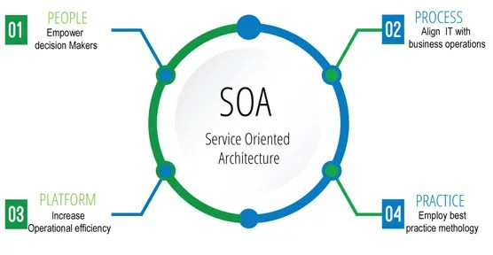
6/5/24, 3:39 PM
Strategic goals
What Is Service-Oriented Architecture? | by Software Development Community | Medium
Intrinsic inter-operability
Shared services Flexibility
Evolutionary refinement
Each of these core values can be seen on a continuum from older format distributed computing to Service-Oriented Architecture to cloud computing (something that is often seen as an offshoot of Service-Oriented Architecture).
Service-Oriented Architecture Patterns
There are three roles in each of the Service-Oriented Architecture building blocks: service provider; service broker, service registry, service repository; and service requester/consumer.
The service provider works in conjunction with the service registry, debating the whys and hows of the services being offered, such as security, availability, what to
https://medium.com/@SoftwareDevelopmentCommunity/what-is-service-oriented-architecture-fa894d11a7ec

Slide 39
6/5/24, 3:39 PM What Is Service-Oriented Architecture? | by Software Development Community | Medium
charge, and more. This role also determines the service category and if there need to be any trading agreements.
The service broker makes information regarding the service available to those requesting it. The scope of the broker is determined by whoever implements it.
The service requester locates entries in the broker registry and then binds them to the service provider. They may or may not be able to access multiple services; that depends on the capability of the service requester.
Implementing Service-Oriented Architecture
When it comes to implementing service-oriented architecture (SOA), there is a wide range of technologies that can be used, depending on what your end goal is and what you’re trying to accomplish.
Typically, Service-Oriented Architecture is implemented with web services, which makes the “functional building blocks accessible over standard internet protocols.”
An example of a web service standard is SOAP, which stands for Simple Object Access Protocol. In a nutshell, SOAP “is a messaging protocol specification for exchanging structured information in the implementation of web services in computer networks. Although SOAP wasn’t well-received at first, since 2003 it has gained more popularity and is becoming more widely used and accepted. Other options for implementing Service-Oriented Architecture include Jini, COBRA, or REST.
It’s important to note that architectures can “operate independently of specific technologies,” which means they can be implemented in a variety of ways, including messaging, such as ActiveMQ; Apache Thrift; and SORCER.
Why Service-Oriented Architecture Is Important
https://medium.com/@SoftwareDevelopmentCommunity/what-is-service-oriented-architecture-fa894d11a7ec

Slide 40
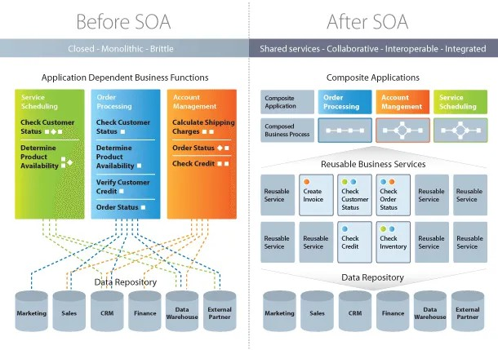
6/5/24, 3:39 PM
What Is Service-Oriented Architecture? | by Software Development Community | Medium
There are many benefits to service-oriented architecture, especially in a web service based business. We’ll outline a few of those benefits here, in brief:
Use Service-Oriented Architecture to create reusable code: Not only does this cut down on time spent on the development process, but there’s no reason to reinvent the coding wheel every time you need to create a new service or process. Service- Oriented Architecture also allows for using multiple coding languages because everything runs through a central interface.
Use Service-Oriented Architecture to promote interaction: With Service-Oriented Architecture, a standard form of communication is put in place, allowing the various systems and platforms to function independent of each other. With this interaction, Service-Oriented Architecture is also able to work around firewalls, allowing “companies to share services that are vital to operations.”
Use Service-Oriented Architecture for scalability: It’s important to be able to scale a business to meet the needs of the client, however certain dependencies can get in the way of that scalability. Using Service-Oriented Architecture cuts back on the client-service interaction, which allows for greater scalability.
Use Service-Oriented Architecture to reduce costs: With Service-Oriented Architecture, it’s possible to reduce costs while still “maintaining a desired level of
https://medium.com/@SoftwareDevelopmentCommunity/what-is-service-oriented-architecture-fa894d11a7ec

Slide 41

6/5/24, 3:39 PM What Is Service-Oriented Architecture? | by Software Development Community | Medium
output.” Using Service-Oriented Architecture allows businesses to limit the amount of analysis required when developing custom solutions.
How Service-Oriented Architecture And Cloud Computing Work Together First, it’s important to note that Service-Oriented Architecture can work with or without cloud computing, although more and more businesses are moving file storage to the cloud so it makes sense to use cloud computing and Service-Oriented Architecture together.
In a nutshell, using cloud computing allows users to easily and immediately implement services tailored to the requirements of their clients, “without needing to consult an IT department.”
One downfall of using Service-Oriented Architecture and cloud computing together is that some aspects of it are not evaluated, such as security and availability. When using cloud computing, users are often at the mercy of the provider.
There is one fairly major challenge businesses face when merging cloud computing and Service-Oriented Architecture is the integration of existing data and systems into the cloud solution. There needs to be continuity from beginning to end in order for there to be a seamless transition. It’s also important to keep in mind that not
https://medium.com/@SoftwareDevelopmentCommunity/what-is-service-oriented-architecture-fa894d11a7ec
6/18

Slide 42
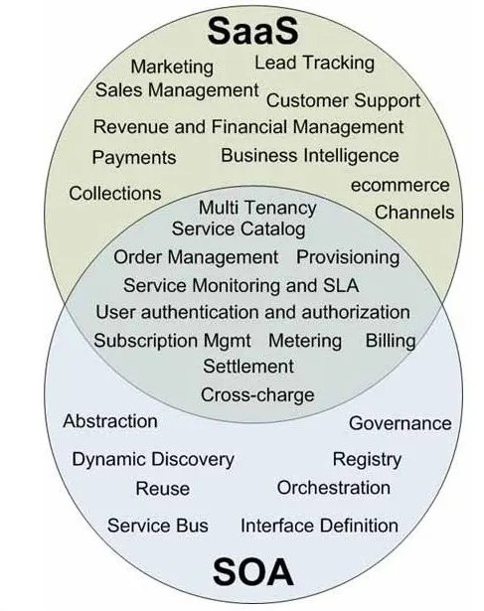
6/5/24, 3:39 PM What Is Service-Oriented Architecture? | by Software Development Community | Medium
every IT aspect can be outsourced to the cloud — there are some things that still need to be done manually.
You can read more about how service-oriented architecture and cloud computing work together right here.
The Difference Between Service-Oriented Architecture and SaaS
We’ve talked quite a bit about what Service-Oriented Architecture is and how it can be used to advance your business. But there’s also SaaS (Software as a Service), which can also be used to advance your business. You may be wondering what SaaS is and how it differs from Service-Oriented Architecture. In brief, the resources available through SaaS are software applications. A key component is that the SaaS infrastructure is “available to, but hidden, from users.” An advantage of SaaS is that users don’t have to both install and maintain software, which eliminates any complex requirements. With SaaS, the customer also doesn’t require any up-front licensing, which leads to lower costs because providers are only maintaining a single application.
Differences Between Service-Oriented Architecture and Microservices
https://medium.com/@SoftwareDevelopmentCommunity/what-is-service-oriented-architecture-fa894d11a7ec

Slide 43
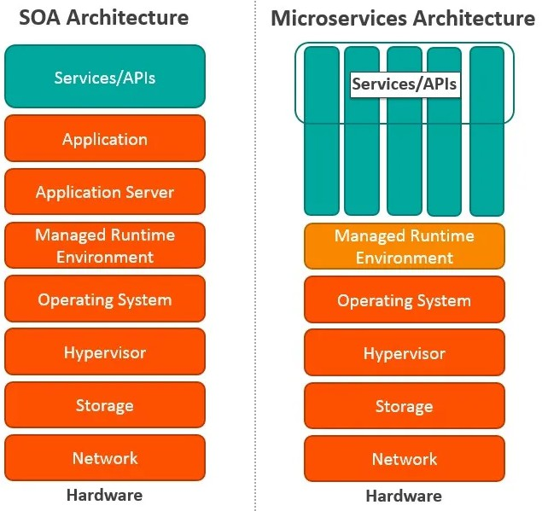
6/5/24, 3:39 PM
What Is Service-Oriented Architecture? | by Software Development Community | Medium
Microservices, also known as Microservice Architecture, is an “architectural style that structures an application as a collection of small autonomous services, modeled around a business domain.”
While microservices and Service-Oriented Architecture are similar in some ways, the key differences come in their functionality. Services is, obviously, the main component of both. There are four basic types of services:
Functional service: these define core business operations
Enterprise service: these implement the functionality defined by the functional services
Application service: these are confined to specific application content
https://medium.com/@SoftwareDevelopmentCommunity/what-is-service-oriented-architecture-fa894d11a7ec

Slide 44

6/5/24, 3:39 PM What Is Service-Oriented Architecture? | by Software Development Community | Medium
Infrastructure service: implements non-functional tasks such as authentication, auditing, security, and logging
As you can see, each of these services builds on the one before it, creating a system that is not only easy to use, but provides you with a variety of ways to manage your business. As with any functionality, it’s a matter of figuring out what works best for you and your business.
You can read more about service-oriented architecture and microservices here.
Some Final Thoughts On Service-Oriented Architecture
As you can imagine, service-oriented architecture can be a bit of a tough nut to crack, but once you understand the nuts and bolts of it and the benefits it can provide your company, you’ll be thrilled you discovered it.
We have provided several excellent service-oriented architecture resources throughout this article and have a couple more articles forthcoming that will take a deeper dive into the concept and provide you with even more resources to help you push your business to the next level.
https://medium.com/@SoftwareDevelopmentCommunity/what-is-service-oriented-architecture-fa894d11a7ec

Slide 45
KISS (Keep It Simple, Stupid)
The KISS (Keep It Simple, Stupid) principle emphasizes simplicity in code design and implementation. According to this principle, it’s better to maintain simple solutions rather than making them complex. Simplicity promotes understanding, maintenance, and problem-solving.
Applying the KISS principle brings several advantages:
Better Code Understanding:
It facilitates code understanding for developers as simple solutions are clearer and more intuitive.
Reduced Errors:
It also reduces the risk of errors and bugs since simple solutions are easier to test and verify.
More Scalable Code:
Simplicity makes code more flexible and scalable as it’s easier to make modifications or add new features to simple code rather than complex code.
Tips
To maintain simplicity in code, it’s important to follow some practical tips.
Firstly, avoid over-engineering and excessive abstractions. Look for simple and straightforward solutions that meet specific needs without adding unnecessary complexity. Also, avoid code repetition and duplication, in line with the DRY principle. By grouping common functionalities and avoiding redundancies, you keep the code clearer and more concise.
Additionally, it’s important to keep variable, function, and class names clear and explicit. Well-chosen names facilitate code understanding and reduce the need for additional comments. Also, avoid premature optimizations and unnecessary complex features. Focus on solving specific problems and add additional features only when truly necessary.

Slide 46
DRY (Don’t Repeat Yourself)
The DRY (Don’t Repeat Yourself) principle emphasizes the elimination of unnecessary code duplication in a software development project. According to this principle, each piece of knowledge or logic should have a single canonical representation within the system.
Let’s explore the benefits offered by the DRY principle.
Reduction of Complexity
First and foremost, it reduces code complexity by avoiding unnecessary repetitions. This makes the code more readable, clear, and easier to understand for developers. Additionally, it simplifies code maintenance, as modifications and fixes only need to be made in one place rather than in multiple parts of the code. Finally, it promotes code reuse, as common functionalities or logics can be encapsulated into functions, classes, or modules that can be used in multiple places within the system.
Elimination of Duplicate Code
To avoid code duplication, there are several techniques that developers can apply. Firstly, extracting functions or methods allows grouping similar and repetitive code blocks into a reusable function. This way, the same code can be called in multiple places without needing to rewrite it.
Grouping by Functionality
Next, the use of classes and inheritance can help encapsulate common functionalities and reuse them in specific subclasses. This way, common functionalities can be defined once in a parent class and inherited in child classes.
Code Reusability
Finally, the use of libraries, modules, or frameworks can aid in reusing code that has already been written and tested by other developers, avoiding the need to reinvent the wheel.

